Slide 1
DISASTER MANAGEMENT ACT AND POLICY
- VAISHNAVI b

Slide 2
Evolution of ndma
High-Powered Committee (HPC) in August 1999
National Committee after the Gujarat earthquake
Disaster Management Act – 23 December 2005
NATIONAL POLICY ON DISASTER MANAGEMENT – 2009
NATONAL DISASTER MANAGEMENT PLAN – 2016
MAJOR DISASTERS IN INDIA
ODISHA SUPER CYCLONE – 1999
Gujarat earthquake – 2001
Indian ocean tsunami – 2004

Slide 3
DISASTER MANAGEMENT ACT, 2005
The national disaster management plan (ndmp) provides a framework and direction to the government agencies for all phases of disaster management cycle.
Dynamic document
National, State, District and Local
Disaster response, funds
Reactive approach (earlier) -> Proactive approach (now)
CBRN – Chemical, Biological , Radiological, Nuclear

Slide 4
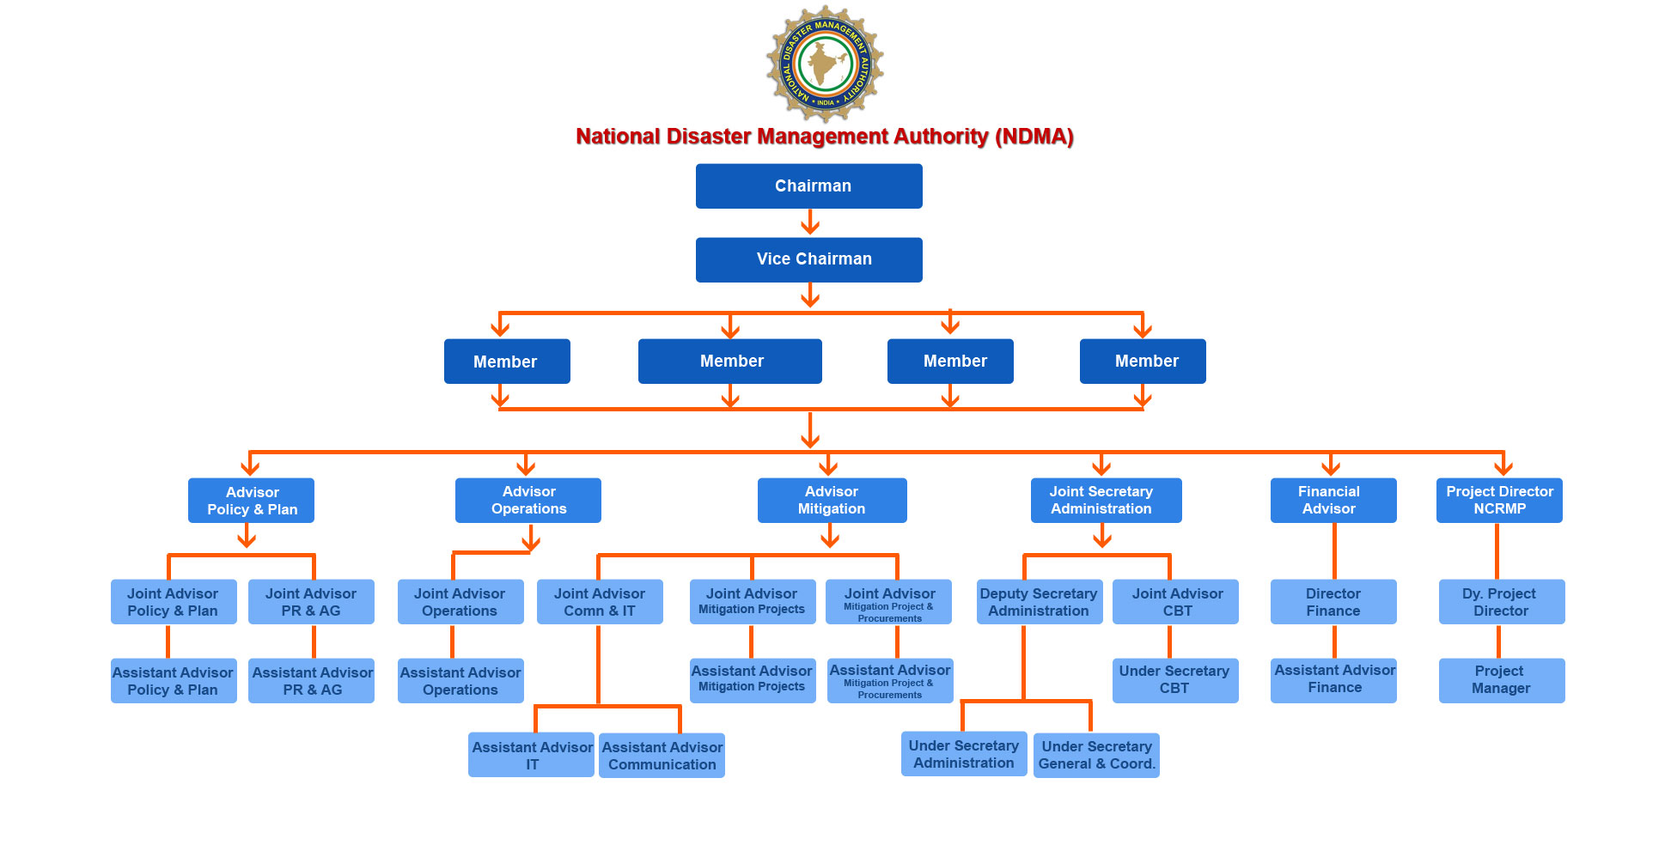

Slide 5
NDMA
Chairperson – prime minister of india
Generally not exceeding nine, will be nominated by the chairperson
Approve the national plan
Recommend provision of funds for the purpose of mitigation
Lay down guidelines to be followed by the state authorities
Provide such support to other countries affected by major disasters
The national executive committee shall assist the national authority in the discharge of its functions and have the responsibility for implementing the policies and plans of the national authority

Slide 6
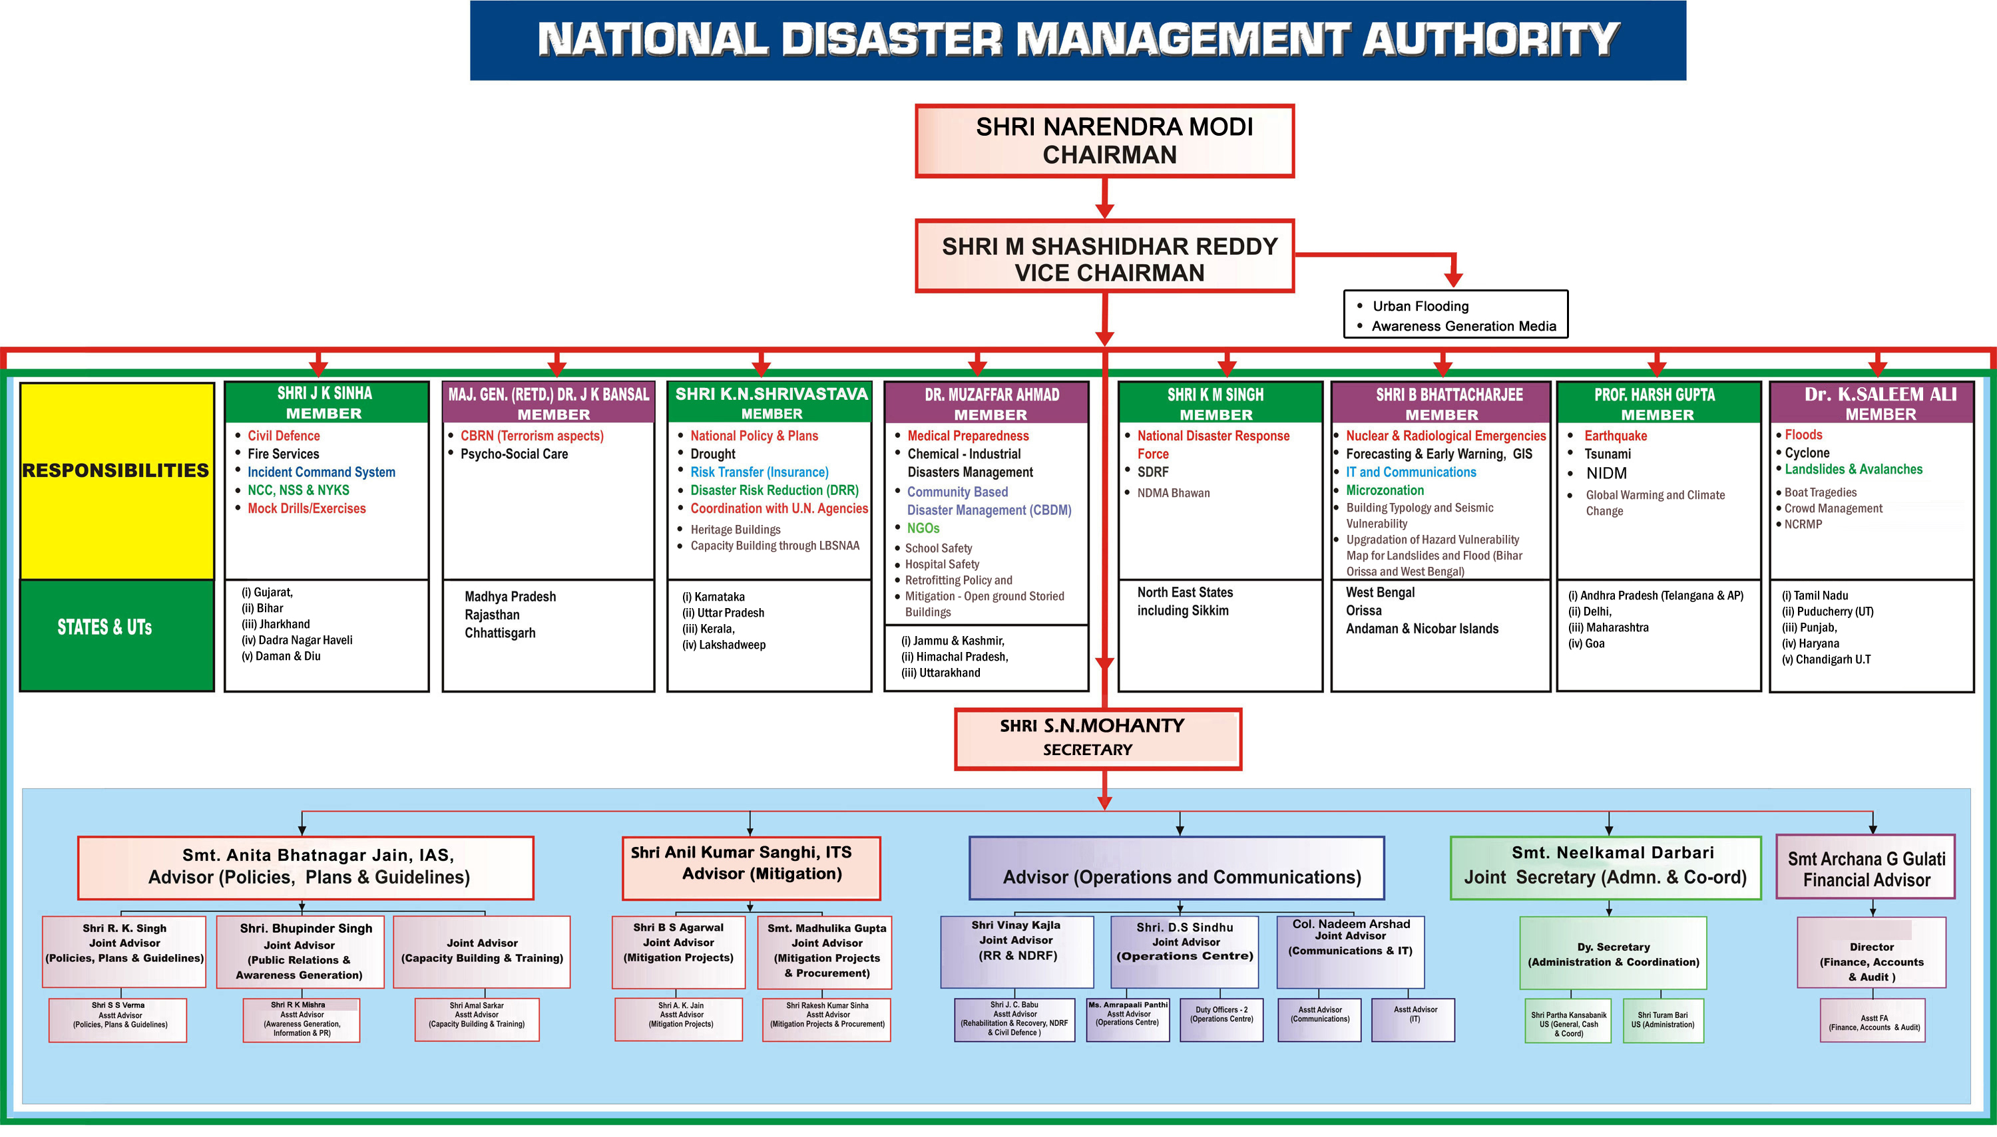

Slide 7
STATE DISASTER MANAGEMENT AUHORITY
Chairperson – chief minister
Other members not exceeding eight will be nominated by the chairperson
State executive committee
Lay down the state disaster management policy
Approve the disaster management plans prepared by the departments of the government of the state
Coordinate the implementation of the state plan
Coordinate and monitor the implementation of the national policy, the national plan and the state plan

Slide 8
measures
Coordination of actions of the ministries or departments of the government of india, state governments
Cooperation and assistance to state governments, as requested by them or otherwise deemed appropriate by it
Establish institutions for research, training, and developmental programmes in the field of disaster management
Carrying out rescue and relief operations
Respond effectively and promptly to any threatening disaster situation
Deployment of naval, military and air forces, other armed forces

Slide 9
DISASTER MANAGEMENT PLAN, 2016
OBJECTIVES
Improve the understanding of disaster risk, hazards, and vulnerabilities
Strengthen disaster risk governance at all levels from local to centre
Increase resilience and prevent the emergence of new disaster risks and reduce the existing risks
Strengthen scientific and technical capabilities in all aspects of disaster management
Invest in disaster risk reduction for resilience through structural, non-structural and financial measures, as well as comprehensive capacity development

Slide 10
HIGHLIGHTS
o Early Warning, Maps, Satellite inputs, Information Dissemination
o Evacuation of People and Animals
o Search and Rescue of People and Animals
o Medical Care
o Drinking Water/ Dewatering Pumps/ Sanitation Facilities/ Public Health
o Food & Essential Supplies
o Communication
o Housing and Temporary Shelters
o Power
o Fuel
o Transportation
o Relief Logistics and Supply Chain Management
o Disposal of Animal Carcasses
o Fodder for livestock in scarcity-hit areas
o Rehabilitation and Ensuring Safety of Livestock and other Animals, Veterinary Care
o Data Collection and Management
o Relief Employment
o Media Relations

Slide 11
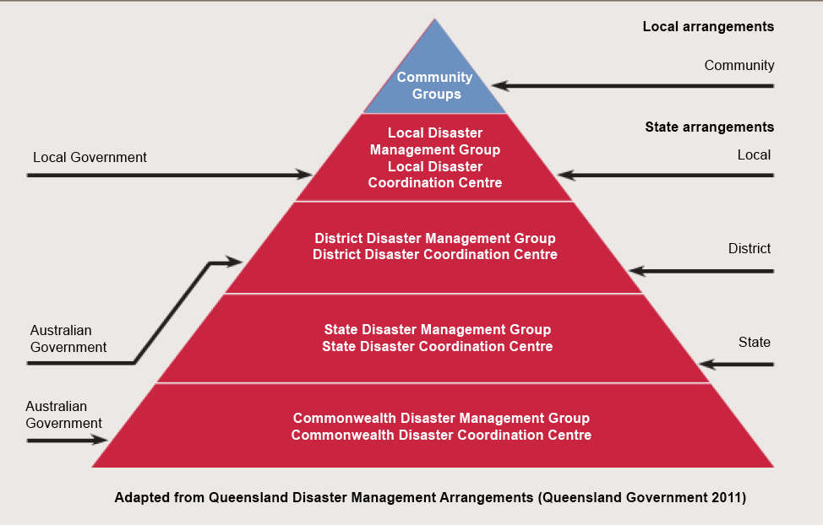
AUSTRALIA

Slide 12
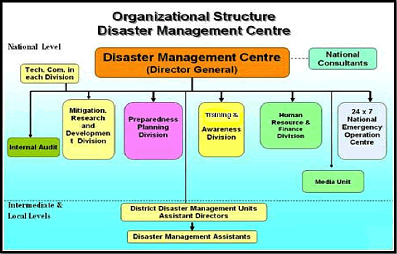
JAPAN

Slide 13
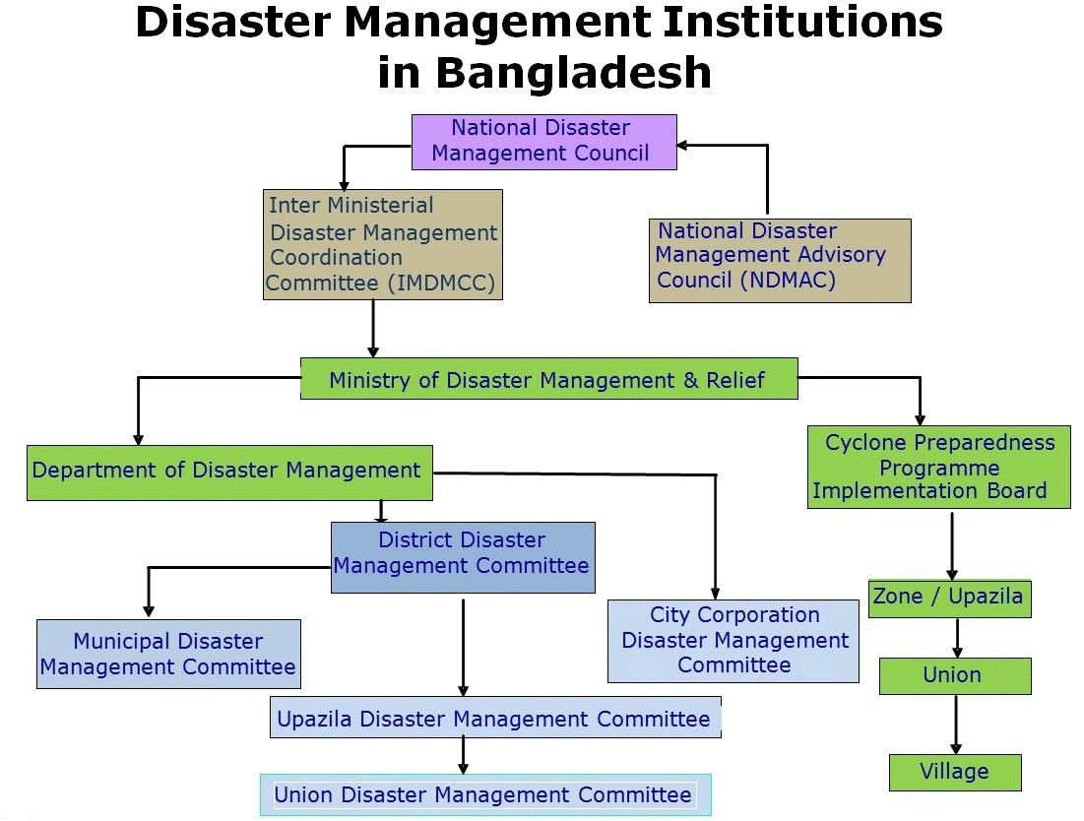
Bangladesh

Slide 14
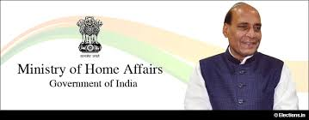
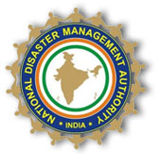
GENERAL INFORMATION
NDMA IS AN AGENCY OF MINISTRY OF HOME AFFAIRS
RAJNATH SINGH
HELPLINE NO – 011-1078
ANNUAL BUDGET - ₹3.56 billion

Slide 15
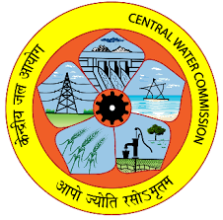
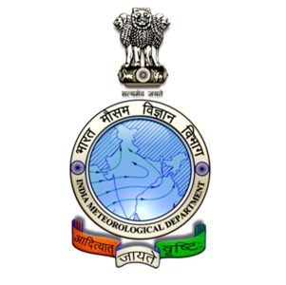
OTHER ORGANIZATIONS
Central water commission Indian meteorological dept
INCOIS – Fishing zones, Early Tsunami Warnings, Coral Bleachings
NRSC - responsible for remote sensing satellite data acquisition and processing, data dissemination, aerial remote sensing and decision support for disaster management.

Slide 16
CASE STUDY
THE WALL STREET JOURNAL
Among the world cities most at risk kolkata ranked sixth, and the indian capital new delhi ninth. The report ranked india as a “high-risk” country, at 49th in vulnerability.
THE HINDU
Scientists predict serious earthquakes in India. Indian subcontinent is pushing under the tibetan plateau at roughly 1.8 meters per century
NASA
Temperatures will continue to rise, more droughts and heat waves, sea-level will rise 1-4 feet by 2100

